Slide 1

Designing CosmosDB workloads for throughput and cost efficiency
https://aka.ms/CosmosDB/AzureMeetupFrankfurt/20210520

Slide 2
Agenda
Introduction
Cosmos DB Overview
NoSQL vs. RDBMS
Common use cases
High availability (HA) and Disaster Recovery (DR)
Overview
Consistency models
Terminology
Trade-offs
Provisioning model
Shared database vs. container specific provisioning
Auto Pilot vs. manually provisioned throughput vs. serverless
RI – Reserved Instances
Cosmos DB APIs
Introduction
Sql/Gremlin/Table
Cassandra/Mongo
Data modeling best practices
Partitioning
Indexing
Point-lookups vs. queries
Common patterns
Document size considerations
Change feed + materialized views
Getting in touch…
https://aka.ms/CosmosDB/AzureMeetupFrankfurt/20210520
Notes:
19:15 – 19:25

Slide 3
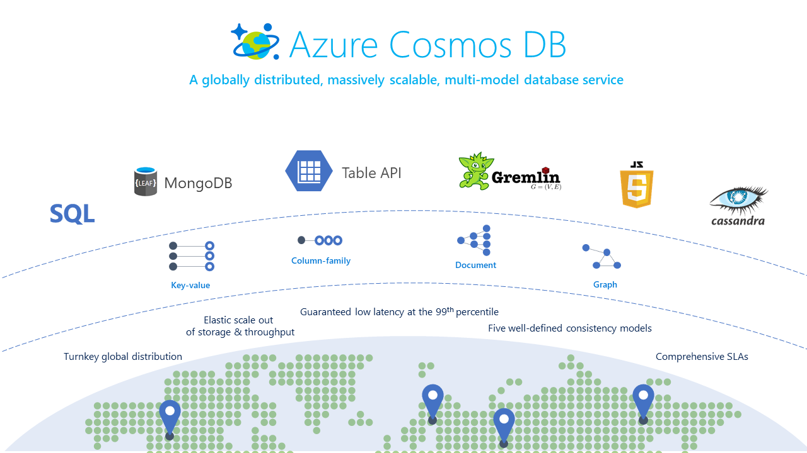
Introduction: Cosmos DB Overview
https://aka.ms/CosmosDB/AzureMeetupFrankfurt/20210520

Slide 4
Introduction: NoSQL vs. RDBMS
CosmosDB – even the Core API (so called Sql Api) is a NoSQL (not only SQL) data service.
Schemaless
Optimized for horizontal scale
Very efficient for point-operations (key/value operation)
No support for distributed transactions - ACID only within the scope of logical partitions (not across containers or even multiple documents in the same container with different logical partition key values)
Supporting SQL-like query language …
… but query engine and indexing works different than in relational databases
Trying to 1:1 migrate relational workloads or data models to Cosmos DB is a recipe for frustration – it is important to understand the fundamental optimizations for point-operations to come up with a data model that works well (I would claim this is true for all NoSQL databases – not just Cosmos DB)
https://aka.ms/CosmosDB/AzureMeetupFrankfurt/20210520

Slide 5
Introduction: Common use cases
Retail/OLTP workloads: Order management, Payment processing, pricing engines, recommendation engines, Inventory management, Product catalogs, user profiles/auth, real-time personalization
IoT: Device telemetry, Device registry, digital twins, dependency management
Financial services: Audit trail, tac forms, underwriting / risk analysis
Gaming: Leaderboards, Social clans/guilds, Messaging
Within Microsoft: Teams, Xbox (Licensing, Authentication, Order Management), AAD, Office 365 (Subscription management), ICM (Internal incident management tool)
https://aka.ms/CosmosDB/AzureMeetupFrankfurt/20210520

Slide 6
Agenda
Introduction
Cosmos DB Overview
NoSQL vs. RDBMS
Common use cases
High availability (HA) and Disaster Recovery (DR)
Overview
Consistency models
Terminology
Trade-offs
Provisioning model
Shared database vs. container specific provisioning
Auto Pilot vs. manually provisioned throughput vs. serverless
RI – Reserved Instances
Cosmos DB APIs
Introduction
Sql/Gremlin/Table
Cassandra/Mongo
Data modeling best practices
Partitioning
Indexing
Point-lookups vs. queries
Common patterns
Document size considerations
Change feed + materialized views
Getting in touch…
https://aka.ms/CosmosDB/AzureMeetupFrankfurt/20210520
Notes:
19:15 – 19:25

Slide 7
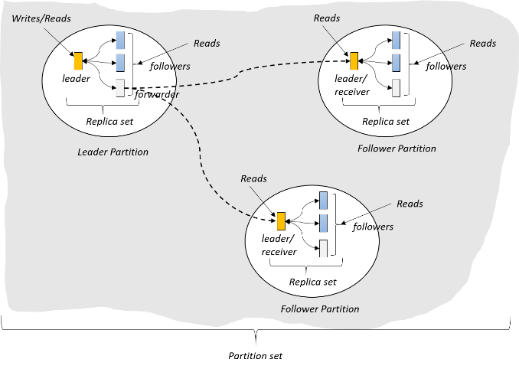
HA and DR: Overview
(West US)
(East US)
(North Europe)
https://aka.ms/CosmosDB/AzureMeetupFrankfurt/20210520

Slide 8
HA and DR: Consistency models
Consistency Level | Guarantees | Read cost factor | Comment
Strong | Linearizability (once operation is complete, it will be visible to all) | 2 | Quorum read (normalized to cost factor of 2 even when reading from three replicas) Only allowed in regions close to each other – no latency or availability SLA guarantees for writes – we can’t control physics ☺
Bounded Staleness | Consistent Prefix. Reads lag behind writes by at most k prefixes or t interval Similar properties to strong consistency (except within staleness window) | 2 | Quorum read (normalized to cost factor of 2 even when reading from three replicas) In single write region identical with Strong – but replication happens asynchronously to other regions
Session | Consistent Prefix. Within a session: monotonic reads, monotonic writes, read-your-writes, write-follows-reads Predictable consistency for a session, high read throughput + low latency | 1 | This is the default consistency model Ideally mutable session token can flow end-to-end – otherwise only single CosmosDB client benefits from predictable consistency within session
Consistent Prefix | Reads will never see out of order writes (no gaps). | 1 | My recommendation (over Session) when it is impossible to flow mutable session token end-to-end because it makes expectations clearer
Eventual | Potential for out of order reads. Lowest cost for reads of all consistency levels. | 1
https://aka.ms/CosmosDB/AzureMeetupFrankfurt/20210520
Notes:
References:
https://docs.microsoft.com/en-us/azure/cosmos-db/consistency-levels
https://docs.microsoft.com/en-us/azure/cosmos-db/consistency-levels-choosing
https://docs.microsoft.com/en-us/azure/cosmos-db/consistency-levels-across-apis
https://docs.microsoft.com/en-us/azure/cosmos-db/consistency-levels-tradeoffs

Slide 9
HA and DR: Terminology
Single-Master vs. Multi-Master: Indicates the replication model. Single-Master means one region is chosen a dedicated write region. All Writes have to be made in this region. (Manual) failover allows choosing another region as the write region. Multi-Master allows writes in all regions. This automatically means in theory conflicts can occur – a strategy for resolving conflicts needs to be chosen/implemented
Availability zone: Availability Zones are physically separate locations within an Azure region. Each Availability Zone is made up of one or more datacenters equipped with independent power, cooling, and networking.
https://aka.ms/CosmosDB/AzureMeetupFrankfurt/20210520

Slide 10
HA and DR: Trade-offs
#Regions | Replication Mode | Consistency Level | AZ redundant | Read Availavility | Write Availability | RPO | RTO | Cost factor
1 | Single Master | * | No | 99.99 | 99.99 | < 240 Minutes | < 1 Week | 1
1 | Single Master | * | Yes | 99.99 | 99.99 | < 240 Minutes | < 1 Week | 1.25
>1 | Single Master | Session, Consistent Prefix, Eventual | No | 99.999 | 99.99 | < 15 minutes | < 15 minutes | #Regions
>1 | Single Master | Bounded Staleness | No | 99.999 | 99.99 | K & T | < 15 minutes | #Regions
>1 | Single Master | Session, Consistent Prefix, Eventual | Yes | 99.999 | 99.99 | < 15 minutes | < 15 minutes | 1.25 * #Regions
>1 | Single Master | Bounded Staleness | Yes | 99.999 | 99.99 | K & T | < 15 minutes | 1.25 * #Regions
>1 | Multi-Master | Session, Consistent Prefix, Eventual | * | 99.999 | 99.999 | < 15 minutes | 0 | 2 * #Regions
>1 | Multi-Master | Bounded Staleness | * | 99.999 | 99.999 | K & T | 0 | 2 * #Regions
>1 | Single-Master | Strong | No | 99.99 | n/a | 0 | < 15 minutes | #Regions
>1 | Multi-Master | Strong | Yes | 99.99 | n/a | 0 | < 15 minutes | 2 * #Regions
"K" is the number of versions of a given data item for which the reads lag behind the writes.
"T" is a given time interval.
“RPO" is the recovery point objective – the maximum targeted period of time in which data (transactions) are lost due to major IT incident
“RTO” is the recovery time objective – the targeted duration of time a service needs to be recovered
https://aka.ms/CosmosDB/AzureMeetupFrankfurt/20210520
Notes:
References:
https://docs.microsoft.com/en-us/azure/cosmos-db/high-availability
https://docs.microsoft.com/en-us/azure/cosmos-db/scaling-throughput
https://docs.microsoft.com/en-us/azure/cosmos-db/global-dist-under-the-hood

Slide 11
Agenda
Introduction
Cosmos DB Overview
NoSQL vs. RDBMS
Common use cases
High availability (HA) and Disaster Recovery (DR)
Overview
Consistency models
Terminology
Trade-offs
Provisioning model
Shared database vs. container specific provisioning
Auto Pilot vs. manually provisioned throughput vs. serverless
RI – Reserved Instances
Cosmos DB APIs
Introduction
Sql/Gremlin/Table
Cassandra/Mongo
Data modeling best practices
Partitioning
Indexing
Point-lookups vs. queries
Common patterns
Document size considerations
Change feed + materialized views
Getting in touch…
https://aka.ms/CosmosDB/AzureMeetupFrankfurt/20210520
Notes:
19:15 – 19:25

Slide 12
Provisioning model
Shared database vs. container specific
Rule of thumb: Always use container specific
Only exception: Consider shared database model when you have multiple containers requiring < 400 RUs/s – but only for those containers. Use dedicated container throughput for containers with higher throughput requirements
Try to avoid enabling shared database throughput for >25 collections
AutoPilot vs. manually provisioning throughput
AutoPilot dynamically manages throughput for you
No 429s except if throughput is above the configured AutoPilot Maximum
Cost-model similar. For every hour: Max(0.1 MaxAPThroughput, MaxConsumedThroughputDuringThatHour)
100 RU/s single master, Manual → 0.08 USD/hour
100 RU/s single master, AP → 0.12 USD/hour
100 RU/s multi master, AP or Manual → 0.16 USD/hour
A tour of Azure Cosmos DB database operations models – YouTube
How to choose between manual and autoscale on Azure Cosmos DB | Microsoft Docs
Serverless (preview)
Good for bursty, intermittent traffic – several restrictions – mostly for Dev/Tests environments → Consumption-based serverless offer in Azure Cosmos DB | Microsoft Docs
https://aka.ms/CosmosDB/AzureMeetupFrankfurt/20210520
Notes:
References:
https://docs.microsoft.com/en-us/azure/cosmos-db/graph-introduction
https://docs.microsoft.com/en-us/azure/cosmos-db/gremlin-support
https://docs.microsoft.com/en-us/azure/cosmos-db/table-introduction

Slide 13
Reserved Capacity Overview
Azure Cosmos DB Reserved Capacity Marginal Discounts
 | 1 Year |  | 3 Year
Throughput | Single Region Writes | Multiple Regions Writes | Single Region Writes | Multiple Regions Writes
First 100K RU/s | 20% | 25% | 30% | 35%
Next 400K RU/s | 25% | 30% | 35% | 40%
Next 2.5M RU/s | 30% | 35% | 45% | 50%
Over 3M RU/s | 45% | 50% | 60% | 65%
Save money by pre-paying for Request Units.
Discounts are up to 65%
Larger reservations and reservations for longer time periods receive bigger discounts
NEW – Pay for the reservation up-front or with monthly payments
https://aka.ms/CosmosDB/AzureMeetupFrankfurt/20210520

Slide 14
Agenda
Introduction
Cosmos DB Overview
NoSQL vs. RDBMS
Common use cases
High availability (HA) and Disaster Recovery (DR)
Overview
Consistency models
Terminology
Trade-offs
Provisioning model
Shared database vs. container specific provisioning
Auto Pilot vs. manually provisioned throughput vs. serverless
RI – Reserved Instances
Cosmos DB APIs
Introduction
Sql/Gremlin/Table
Cassandra/Mongo
Data modeling best practices
Partitioning
Indexing
Point-lookups vs. queries
Common patterns
Document size considerations
Change feed + materialized views
Getting in touch…
https://aka.ms/CosmosDB/AzureMeetupFrankfurt/20210520
Notes:
19:15 – 19:25

Slide 15
Cosmos DB APIs: Introduction
The “Sql” Api should probably have been named the “Core” Api. It basically rules them all.
Client (Sql API)
Client resolved partition key and communicates
directly with the backend node
Database engine operates on atom-record-sequence (ARS) based type system
All data models are translated to ARS
Overly-Simplified…
Client (XZY Api)
XYZ-Protocol
Gateway
Gateway resolved partition key and communicates
directly with the backend node
XYZ wire protocol
Gateway compute layer as protocol head adds additional hop and RU charges
https://aka.ms/CosmosDB/AzureMeetupFrankfurt/20210520
Notes:
References:
https://azure.microsoft.com/en-us/blog/a-technical-overview-of-azure-cosmos-db/

Slide 16
Cosmos DB APIs: Sql/Gremlin/Table
Sql/Core
Recommended as “default” for green-field.
Allows access to features early (change feed, bulk executor library, Spark connector etc.)
Usually lowest cost and best performance (one less hop)
Careful with “lift&shift” migrations from traditional relational Sql (Server) workloads – data model often needs to be optimized for horizontal scale (PK)
Gremlin/Graph
Allows Multi-Api access. Meaning Gremlin account can be used via SQL/Core Api client as well. Edge and Vertex documents are stored as “normal” Sql/Core documents with few additional system properties
Table
Currently only recommended for lift & shift of hot-storage workloads (heavy load on relatively small storage)
Automatic migration form legacy Azure Table Service offering when cold storage offer available in CosmosDB
No change-feed support
https://aka.ms/CosmosDB/AzureMeetupFrankfurt/20210520
Notes:
References:
https://docs.microsoft.com/en-us/azure/cosmos-db/graph-introduction
https://docs.microsoft.com/en-us/azure/cosmos-db/gremlin-support
https://docs.microsoft.com/en-us/azure/cosmos-db/table-introduction

Slide 17
Cosmos DB APIs: Cassandra/Mongo
Cassandra
Schema required
Data stored compressed – until “hybrid row” support for Sql/Core Api and Mogo gets released good candidate for cold-storage scenarios
CCX (+ Managed Instance (preview)) allows hybrid-cloud migration. CosmosDB Cassandra API participates in Cassandra replication protocol – so data will be available in Cassandra replicas as well as in Cassandra Api in CosmosDB → Now in preview: Azure Managed Instance for Apache Cassandra | Azure Cosmos DB Blog (microsoft.com)
Note: the underlying storage engine is the same as for Sql/Core, so no Append-only storage. As a result partial updates aren’t as efficient as with pure Cassandra (yet)
Lift & shift usually works well – only few possible incompatibilities like LWT
Compatibility
Mongo
Design for horizontal scale (shard key)!
Significant improvements to the aggregation pipeline coming
Currently support for protocol version 3.2, 3.6 and 4.0 – 4.2 targeted for later this year
Lift & shift sometimes problematic, Some feature gaps (aggregation pipeline, see supported features for different Mongo Api versions below, existing solutions often not designed for horizontal scale – can result in hot partitions/high cost)
Compatibility:
4.0
3.6
3.2
https://aka.ms/CosmosDB/AzureMeetupFrankfurt/20210520
Notes:
References:
https://docs.microsoft.com/en-us/azure/cosmos-db/cassandra-introduction
https://docs.microsoft.com/en-us/azure/cosmos-db/cassandra-support
https://docs.microsoft.com/en-us/azure/cosmos-db/mongodb-introduction
https://docs.microsoft.com/en-us/azure/cosmos-db/mongodb-feature-support

Slide 18
Agenda
Introduction
Cosmos DB Overview
NoSQL vs. RDBMS
Common use cases
High availability (HA) and Disaster Recovery (DR)
Overview
Consistency models
Terminology
Trade-offs
Provisioning model
Shared database vs. container specific provisioning
Auto Pilot vs. manually provisioned throughput vs. serverless
RI – Reserved Instances
Cosmos DB APIs
Introduction
Sql/Gremlin/Table
Cassandra/Mongo
Data modeling best practices
Partitioning
Indexing
Point-lookups vs. queries
Common patterns
Document size considerations
Change feed + materialized views
Getting in touch…
https://aka.ms/CosmosDB/AzureMeetupFrankfurt/20210520
Notes:
19:15 – 19:25

Slide 19
Partitioning: Overview
Leveraging Azure Cosmos DB to automatically scale your data across the globe
This module will reference partitioning in the context of all Azure Cosmos DB modules and APIs.
https://aka.ms/CosmosDB/AzureMeetupFrankfurt/20210520

Slide 20
Partitioning: Partitions
Partition Key: User ID
Cosmos DB Container (e.g. Collection)
Logical Partitioning Abstraction
Behind the Scenes:
Physical Partition Sets
hash(User ID)
Psuedo-random distribution of data over range of possible hashed values
https://aka.ms/CosmosDB/AzureMeetupFrankfurt/20210520

Slide 21
Partitioning: Partitions
hash(User ID)
Pseudo-random distribution of data over range of possible hashed values
Andrew
Mike
…
Bob
Dharma
Shireesh
Karthik
Rimma
Alice
Carol
…
…
Partition 1
Partition 2
Partition n
Frugal # of Partitions based on actual storage and throughput needs
(yielding scalability with low total cost of ownership)
https://aka.ms/CosmosDB/AzureMeetupFrankfurt/20210520

Slide 22
Partitioning: Partitions
hash(User ID)
Pseudo-random distribution of data over range of possible hashed values
Andrew
Mike
…
Bob
Dharma
Shireesh
Karthik
Rimma
Alice
Carol
…
…
Partition 1
Partition 2
Partition n
What happens when partitions need to grow?
https://aka.ms/CosmosDB/AzureMeetupFrankfurt/20210520

Slide 23
Partitioning: Partitions
hash(User ID)
Pseudo-random distribution of data over range of possible hashed values
Partition Ranges can be dynamically sub-divided to seamlessly grow database as the application grows while simultaneously maintaining high availability.
Partition management is fully managed by Azure Cosmos DB, so you don't have to write code or manage your partitions.
Dharma
Shireesh
Karthik
Rimma
Alice
Carol
…
Dharma
Shireesh
…
Rimma
Karthik
…
+
Partition x
Partition x1
Partition x2
https://aka.ms/CosmosDB/AzureMeetupFrankfurt/20210520

Slide 24
Partition Design
IMPORTANT TO SELECT THE “RIGHT” PARTITION KEY
Partition keys acts as a means for efficiently routing queries and as a boundary for multi-record transactions.
KEY MOTIVATIONS
Distribute Requests
Distribute Storage
Intelligently Route Queries for Efficiency
https://aka.ms/CosmosDB/AzureMeetupFrankfurt/20210520

Slide 25
Partitions
Best Practices: Design Goals for Choosing a Good Partition Key
Distribute the overall request + storage volume
Avoid “hot” partition keys
Partition Key is scope for multi-record transactions and routing queries
Queries can be intelligently routed via partition key
Omitting partition key on query requires fan-out
Steps for Success
Ballpark scale needs (size/throughput)
Understand the workload
# of reads/sec vs writes per sec
Use pareto principal (80/20 rule) to help optimize bulk of workload
For reads – understand top 3-5 queries (look for common filters)
For writes – understand transactional needs
General Tips
Build a POC to strengthen your understanding of the workload and iterate (avoid analyses paralysis)
Don’t be afraid of having too many partition keys
Partitions keys are logical
More partition keys  more scalability
https://aka.ms/CosmosDB/AzureMeetupFrankfurt/20210520

Slide 26
Partition Key storage limits
HTTP 403
Containers support unlimited storage by dynamically allocating additional physical partitions
Storage for single partition key value (logical partition) is quota'ed to 20GB.
When a partition key reaches its provisioned storage limit, requests to create new resources will return a HTTP Status Code of 403 (Forbidden).
Azure Cosmos DB will automatically add partitions, and may also return a 403 if:
An authorization token has expired
A programmatic element (UDF, Stored Procedure, Trigger) has been flagged for repeated violations
https://aka.ms/CosmosDB/AzureMeetupFrankfurt/20210520

Slide 27





Partition Design
EXAMPLE SCENARIO
Contoso Connected Car is a vehicle telematics company. They are planning to store vehicle telemetry data from millions of vehicles every second in Azure Cosmos DB to power predictive maintenance, fleet management, and driver risk analysis.
The partition key we select will be the scope for multi-record transactions.
WHAT ARE A FEW POTENTIAL PARTITION KEY CHOICES?
Vehicle Model
Current Time
Device Id
Composite Key – Device ID + Current Time
https://aka.ms/CosmosDB/AzureMeetupFrankfurt/20210520
Example – Contoso Connected Car

Slide 28
Partition Key Choices
VEHICLE MODEL (e.g. Model A)
Most auto manufactures only have a couple dozen models. This will create a fixed number of logical partition key values; and is potentially the least granular option.
Depending how uniform sales are across various models – this introduces possibilities for hot partition keys on both storage and throughput.
CURRENT MONTH (e.g. 2018-04)
Auto manufacturers have transactions occurring throughout the year. This will create a more balanced distribution of storage across partition key values.
However, most business transactions occur on recent data creating the possibility of a hot partition key for the current month on throughput.
Storage Distribution
Throughput Distribution
Storage Distribution
Throughput Distribution
Rodel
Rodel
2018-03
2018-03
Prisma
Prisma
2018-04
2018-04
Turlic
Turlic
2018-05
2018-05
Coash
Coash
2018-06
2018-06
https://aka.ms/CosmosDB/AzureMeetupFrankfurt/20210520
Example – Contoso Connected Car

Slide 29
Partition Key Choices
DEVICE ID (e.g. Device123)
Each car would have a unique device ID. This creates a large number of partition key values and would have a significant amount of granularity.
Depending on how many transactions occur per vehicle, it is possible to a specific partition key that reaches the storage limit per partition key
COMPOSITE KEY (Device ID + Time)
This composite option increases the granularity of partition key values by combining the current month and a device ID. Specific partition key values have less of a risk of hitting storage limitations as they only relate to a single month of data for a specific vehicle.
Throughput in this example would be distributed more to logical partition key values for the current month.
Storage Distribution
Throughput Distribution
Storage Distribution
Throughput Distribution
C49E27EB
C49E27EB
C49E27EB-2018-05
C49E27EB-2018-05
FE53547A
FE53547A
C49E27EB-2018-06
C49E27EB-2018-06
E84906BE
E84906BE
4376B4BC-2018-05
4376B4BC-2018-05
4376B4BC
4376B4BC
4376B4BC-2018-06
4376B4BC-2018-06
https://aka.ms/CosmosDB/AzureMeetupFrankfurt/20210520
Example – Contoso Connected Car

Slide 30
Partition Granularity
SELECT THE “RIGHT” LEVEL OF GRANULARITY FOR YOUR PARTITIONS
Partitions should be based on your most often occurring query and transactional needs. The goal is to maximize granularity and minimize cross-partition requests.
RODEL
RODEL_2017
RODEL_2017_LX
RODEL_2017_EX
RODEL_2018
RODEL_2018_LX
Don’t be afraid to have more partitions! More partition keys = More scalability
https://aka.ms/CosmosDB/AzureMeetupFrankfurt/20210520
Example – Contoso Connected Car

Slide 31
Partition Granularity
SELECT THE “RIGHT” LEVEL OF GRANULARITY FOR YOUR PARTITIONS
Consider storage & throughput thresholds
Consider cross-partition query likelihood
RODEL
RODEL_2017
RODEL_2017_LX
RODEL_2017_EX
RODEL_2018
RODEL_2018_LX
Don’t be afraid to have more partitions! More partition keys = More scalability
https://aka.ms/CosmosDB/AzureMeetupFrankfurt/20210520
Example – Contoso Connected Car

Slide 32
Partition Granularity
A CROSS-PARTITION QUERY IS NOT ALWAYS A BLIND FAN OUT QUERY
SELECT * FROM C
RODEL
RODEL_2017
RODEL_2017_LX
RODEL_2017_EX
RODEL_2018
RODEL_2018_LX
SELECT * FROM C WHERE partitionKey IN (A, B, C)
https://aka.ms/CosmosDB/AzureMeetupFrankfurt/20210520
Example – Contoso Connected Car

Slide 33
Partitioning: Sub-Partitioning
New capability – SubPartitioning – targeted for end-of-year 2021
Allows specifying a partition key based on multiple fields - for example Device Model and Device Id
This would result in all Devices of a certain model being co-located on a single or multiple physical partitions. Allows to scale for a single Device Model > 20 GB data / 10,000 RU – but still allows queries to only target a small subset of physical partitions
https://aka.ms/CosmosDB/AzureMeetupFrankfurt/20210520
Notes:
References:
https://docs.microsoft.com/en-us/azure/cosmos-db/partitioning-overview
https://docs.microsoft.com/en-us/azure/cosmos-db/partition-data

Slide 34
Partitioning: Summary
A good partition key is expected to have the following characteristics-
The data distribution is reasonably even across all the keys, i.e., you don’t want to have a select few keys to have the majority of the data.
The workload is reasonably even across all the keys, i.e., you don’t want the (majority of the) workload to be focused on a few specific keys.
Generally prefer to have more keys. The large the keys the better.
PartitionKey is known and can be provided for CRUD operations and ideally most common queries
If you have the need to be able to update multiple documents within the same atomic transaction (via triggers or Stored Procedures) they need to share the same logical partition key.
https://aka.ms/CosmosDB/AzureMeetupFrankfurt/20210520
Notes:
References:
https://docs.microsoft.com/en-us/azure/cosmos-db/partitioning-overview
https://docs.microsoft.com/en-us/azure/cosmos-db/partition-data

Slide 35
Indexing
Schema-agnostic, automatic indexing : Handle any data without manual schema or index management
At global scale, schema/index management is painful
Automatic and synchronous index management
Hash, range, and geospatial
Works across every data model
Highly write-optimized database engine
Schema
Physical index
https://aka.ms/CosmosDB/AzureMeetupFrankfurt/20210520

Slide 36
Indexing
Tuning Index policy
By default all nodes are indexed. Request units are charged for indexing during Writes (POST/PUT) – each term being indexed costs a fragment of an RU – but especially for documents larger 1 KB tuning the index policy to only index nodes that are queries by reduces cost for Writes
https://aka.ms/CosmosDB/AzureMeetupFrankfurt/20210520
Notes:
References:
https://docs.microsoft.com/en-us/azure/cosmos-db/index-overview
https://docs.microsoft.com/en-us/azure/cosmos-db/index-policy

Slide 37
Point-lookups vs. queries
Point-lookups vs. queries
For heavy read/query scenarios it can be beneficial to denormalize data to allow retrieval by point-lookups vs. queries to avoid the RU charges for compute overhead with queries
RU charge for point-lookup of 1 KB document (with Session or lower consistency) is 1 RU.
Query ‘SELECT * FROM c WHERE c.id == “<RowKey>” and c.pk == “<PartitionKey>”’ for the same document would cost nearly 3 RU
Often only useful when certain queries are executed very often. Example: Xbox Licensing service with around 100 K requests per second saved roughly 25% of RUs with this optimization
https://aka.ms/CosmosDB/AzureMeetupFrankfurt/20210520

Slide 38
Data model: Common patterns
IoT Write-Heavy, in many cases the intuitive PK DeviceId would result in skweness, often pretty much free form query requirements with only common filtering base don time (last x days)
Consider: Model where time-fragment is part of CollectionName – like “Events20191121”, “Events20191122” etc. (could be based on week, month or year based on volume instead). Consider using “/id” as PK (very well distribution for ingestion, makes cross partition keys required, but with the Collection model above number of partitions is very limited)
Multi-Tenancy
Hard trade-off between different options:
TenantId as (part of) partition key
Different Containers for each tenant
Consider a mixed model – like shared Container where TenantId is (part of) partition key for free beta testers, but dedicated containers for you whale accounts
https://aka.ms/CosmosDB/AzureMeetupFrankfurt/20210520
Notes:
References:
https://docs.microsoft.com/en-us/azure/cosmos-db/partitioning-overview
https://docs.microsoft.com/en-us/azure/cosmos-db/partition-data

Slide 39
Data model: Common patterns
Read-heavy:
Optimize data-model for point lookups vs. queries
Understand and optimize the Top N queries
Implement pagination logic in your REST endpoints that can be efficient
Example:
UST Entitlements Service
https://aka.ms/CosmosDB/AzureMeetupFrankfurt/20210520
Notes:
References:
https://docs.microsoft.com/en-us/azure/cosmos-db/partitioning-overview
https://docs.microsoft.com/en-us/azure/cosmos-db/partition-data

Slide 40
Data model: Common patterns
Example: Original pseudo contract
{
“id”: “<Guid>”,
“EntitlementKey”: “big:ProductId:SkuId”,
“UserId”: “SomeUser”,
“Status”: “Active”
[…]
}
ProductId/SkuId identify the digital good, could be a game, a subscriptions, consumables like bullets that can be used in a game (1 user could own multiple entitlements for the same ProductId/SkuId combination)
Typical query pattern: SELECT e.* FROM e WHERE e.UserId in (“User123”, “UserABC”, “Device789”) AND e.Status == “Active” AND e.EntitlementKey == “big:Halo5:GoldEdition”
Problems:
Query vs. Point-lookup
Query plan/Execution order:
Complexity, Order of Filter criteria vs. statistics (* to be changed )
https://aka.ms/CosmosDB/AzureMeetupFrankfurt/20210520
Notes:
References:
https://docs.microsoft.com/en-us/azure/cosmos-db/partitioning-overview
https://docs.microsoft.com/en-us/azure/cosmos-db/partition-data

Slide 41
Data model: Common patterns
Example: Optimized pseudo contract
{
“id”: “big:ProductId:SkuId”,
“UserId”: “SomeUser”,
“Entitlements”: [
{
“EntitlementId”: “<Guid>”,
“Status”: “Active”,
[…]
}[, …]
]
}
Caution: Not a general best practice – mileage will vary based on use case. But worth considering…
Most common Query pattern (by EntitlementKey for a set of users) would be executable by point lookups + some in-memory filtering (like status==active)
For remaining queries ensure Single UserId as first filter (to make sure it is always processed first)
Some very unselective filter criteria (>99% of entitlement “Active”) consider filtering in memory instead
https://aka.ms/CosmosDB/AzureMeetupFrankfurt/20210520
Notes:
References:
https://docs.microsoft.com/en-us/azure/cosmos-db/partitioning-overview
https://docs.microsoft.com/en-us/azure/cosmos-db/partition-data

Slide 42
Document size considerations
Modeling for smaller document sizes
CosmosDB has a hard limit of 2MB (soon increasable to up-to 16 MB) per document
Request units being charged for read/query as well as writes depend on the document payload. So especially in scenarios where documents are often retrieved or updated it is often preferable to split documents.
When storing multiple documents with the same logical partition key within the same collections Transactional Batch API or stored procedures can be used for updates across documents within atomic transactions
https://aka.ms/CosmosDB/AzureMeetupFrankfurt/20210520

Slide 43

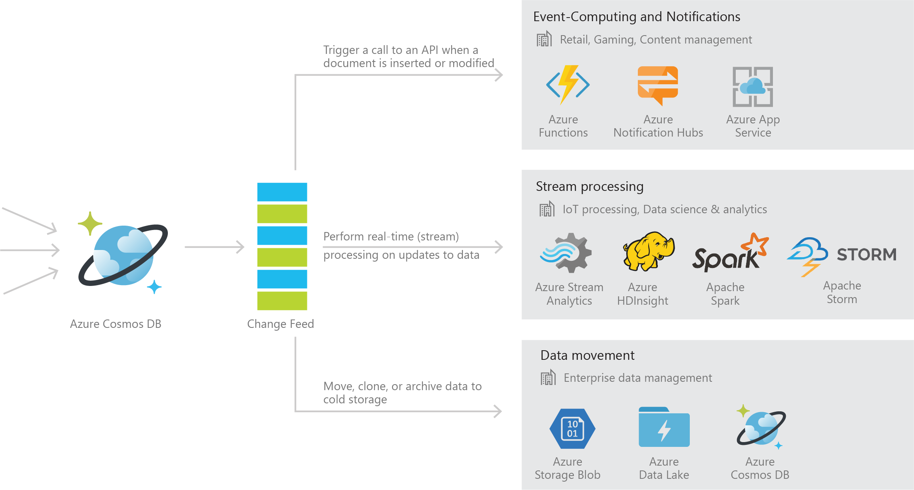
Cosmos DB change feed
Persistent log of records within an Azure Cosmos DB container in the order in which they were modified
Notes:
References
https://docs.microsoft.com/en-us/azure/cosmos-db/change-feed
https://docs.microsoft.com/en-us/azure/cosmos-db/change-feed-processor
https://lennilobel.wordpress.com/2019/04/08/change-feed-unsung-hero-of-azure-cosmos-db/
https://lennilobel.wordpress.com/2019/04/27/multiple-partition-keys-in-azure-cosmos-db-part-1-querying-the-change-feed-directly/
https://lennilobel.wordpress.com/2019/05/06/multiple-partition-keys-in-azure-cosmos-db-part-2-using-the-change-feed-processor-library/
https://lennilobel.wordpress.com/2019/06/04/multiple-partition-keys-in-azure-cosmos-db-part-3-azure-functions-with-change-feed-trigger/
https://docs.microsoft.com/en-us/azure/cosmos-db/how-to-configure-cosmos-db-trigger-connection-policy
https://docs.microsoft.com/en-us/azure/cosmos-db/how-to-create-multiple-cosmos-db-triggers
https://docs.microsoft.com/en-us/azure/cosmos-db/troubleshoot-changefeed-functions
https://github.com/ealsur/serverless-recipes
https://github.com/ealsur/serverlessazurefriday
https://azure.microsoft.com/en-us/resources/videos/azure-friday-serverless-geo-distributed-applications-with-azure-cosmos-db/

Slide 44


Event Sourcing for Microservices
Trigger Action From Change Feed
Persistent Event Store
Microservice
#1
Microservice #2
New Event
…
Microservice #N

Slide 45

Materializing Views
Application
Cosmos DB
Materialized View
Subscription | User | Create Date | …
123abc | Ben6 | 6/17/17
456efg | Ben6 | 3/14/17
789hij | Jen4 | 8/1/16
012klm | Joe3 | 3/4/17
User | Total Subscriptions
Ben6 | 2
Jen4 | 1
Joe3 | 1

Slide 46


Replicating Data
Secondary Datastore (e.g. archive)
Replicate Records
CRUD Data

Slide 47
Change Feed with partitions
Consumer parallelization
Change feed listens for any changes in Azure Cosmos DB collection. It then outputs the sorted list of documents that were changed in the order in which they were modified.
The changes are persisted, can be processed asynchronously and incrementally, and the output can be distributed across one or more consumers for parallel processing. The change feed is available for each partition key range within the document collection, and thus can be distributed across one or more consumers for parallel processing.
Event/stream processing app tier
Consumer 3
Consumer 2
Consumer 1

Slide 48
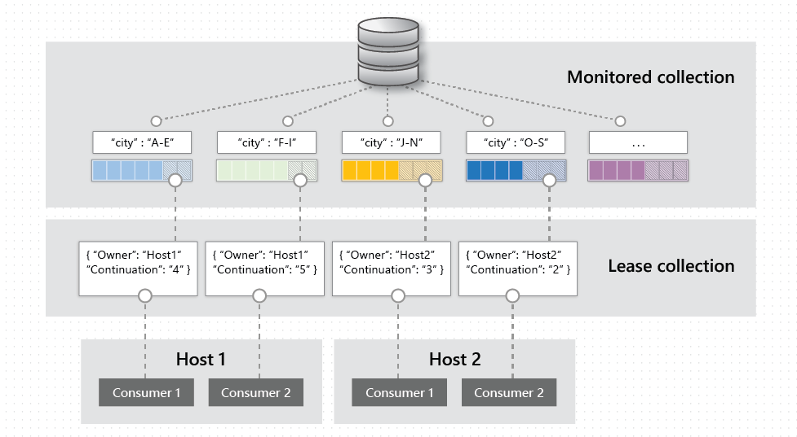
Behind the Scenes

Slide 49
Agenda
Introduction
Cosmos DB Overview
NoSQL vs. RDBMS
Common use cases
High availability (HA) and Disaster Recovery (DR)
Overview
Consistency models
Terminology
Trade-offs
Provisioning model
Shared database vs. container specific provisioning
Auto Pilot vs. manually provisioned throughput vs. serverless
RI – Reserved Instances
Cosmos DB APIs
Introduction
Sql/Gremlin/Table
Cassandra/Mongo
Data modeling best practices
Partitioning
Indexing
Point-lookups vs. queries
Common patterns
Document size considerations
Change feed + materialized views
Getting in touch…
https://aka.ms/CosmosDB/AzureMeetupFrankfurt/20210520
Notes:
19:15 – 19:25

Slide 50
Getting in touch …
Engineering
Fabian Meiswinkel (fabianm@microsoft.com)
Product management
Theo van Kraay (theo.van@microsoft.com)
https://aka.ms/CosmosDB/AzureMeetupFrankfurt/20210520

